Slide 1
NVIDIA Market Analytics
Capstone Project: Regression, Classification & Time-Series Analysis
Presented by: Pushkar B
BCHBA504 Capstone Project| B.Com (Hons), Manipal University of Higher Education
Dataset: nvidia_market_analytics.csv (supplied; see data caveat in notes)
Notes:
Capstone on a supplied NVIDIA market analytics dataset (regression, classification, time series). The file looks synthetic/constructed, so findings are educational, not NVIDIA's real financial results.

Slide 2
1. Overview of Context & Data
Problem statement
Which commercial, customer and market factors explain NVIDIA product sales revenue, and how can revenue be smoothed and projected over time?
Target variables
• Log(Sales Revenue (USD)): regression target
• High_Revenue (revenue ≥ median): classification target
Records: 39,298 | Period: 1993–2024
Feature variables
Numeric: Units Sold, Customer Satisfaction, Marketing Spend (USD), Discount Percentage (%), Return Rate (%), AI/ML Adoption Rate (%), Ad Campaign Effectiveness, Customer Retention Rate (%), Market Share (%)
Time: Date_Year, Date_Month
Categorical: Product Category, Product Name, Region, Customer Segment, Customer Type, Competitor Influence, Competitor Product
Interpretation: We model how commercial and customer drivers explain sales revenue.
2
Notes:
Dataset: 39,298 records x 19 variables, April 1993 to October 2024. 0 exact duplicates; only 23 missing cells (negligible, imputed). Problem: which commercial/customer factors explain sales revenue. Targets: Log(Sales Revenue) for regression and High_Revenue (revenue >= median) for classification. Revenue is log-transformed because it is strongly right-skewed.

Slide 3
2a. Data Description & Classification
Type | Variables
Numeric (continuous/discrete) | Units Sold, Customer Satisfaction, Marketing Spend (USD)
Numeric (continuous/discrete) | Discount Percentage (%), Return Rate (%), AI/ML Adoption Rate (%)
Numeric (continuous/discrete) | Sales Revenue (USD), Ad Campaign Effectiveness, Customer Retention Rate (%), Market Share (%)
Categorical (nominal) | Product Category, Product Name, Region
Categorical (nominal) | Customer Segment, Customer Type
Categorical (nominal) | Competitor Influence, Competitor Product
Date/Time | Date, Product Launch Date, Month
Interpretation : 10 numeric (ratio/interval) and 7 categorical (nominal) variables.
3
Notes:
10 numeric variables (revenue, units, spend, discount %, return %, AI/ML adoption %, retention %, market share %, satisfaction, ad effectiveness) are ratio/interval data. 7 categorical variables (product category/name, region, customer segment/type, competitor influence/product) are nominal and one-hot encoded. Dates give Year/Month and the time series.

Slide 4
2b. Descriptive Statistics (Central Tendency & Spread)
Variable | mean | median | SD | min | max | skew
Units Sold | 2,545.89 | 2,532.00 | 1,414.50 | 100.00 | 5,000.00 | 0.0066
Customer Satisfaction | 3.0004 | 3.0000 | 1.1552 | 1.0000 | 5.0000 | -0.0016
Marketing Spend (USD) | 105,293.13 | 105,158.11 | 54,876.62 | 10,002.09 | 199,996.89 | -0.0045
Discount Percentage (%) | 12.43 | 12.00 | 7.4813 | 0.00 | 25.00 | 0.0154
Return Rate (%) | 2.5440 | 2.5400 | 1.4104 | 0.1000 | 5.0000 | 0.0071
AI/ML Adoption Rate (%) | 50.16 | 50.00 | 23.46 | 10.00 | 90.00 | -0.0052
Ad Campaign Effectiveness | 0.1751 | 0.1700 | 0.0721 | 0.0500 | 0.3000 | 0.0021
Customer Retention Rate (%) | 69.93 | 70.00 | 11.85 | 50.00 | 90.00 | 0.0024
Market Share (%) | 49.98 | 50.04 | 11.60 | 30.00 | 70.00 | -0.0020
Sales Revenue (USD) | 41,381,935,579.73 | 307,450,798.38 | 148,505,764,892.65 | 280,003,084.24 | 1,119,957,875,154.01 | 4.4511
Interpretation : Revenue skewness is 4.45: mean and median differ sharply, so medians/logs are used.
4
Notes:
Every predictor is symmetric and evenly spread (skew about 0; mean ~ median, e.g. Units Sold mean 2,546 vs median 2,532; Satisfaction 3.00 vs 3.00; Market Share 49.98 vs 50.04). Sales Revenue is the opposite: mean $41.4B but median only $307M, SD $148.5B, skew 4.45. A few extremely large records pull the mean far above the typical value, so medians and log transforms are the right tools.

Slide 5
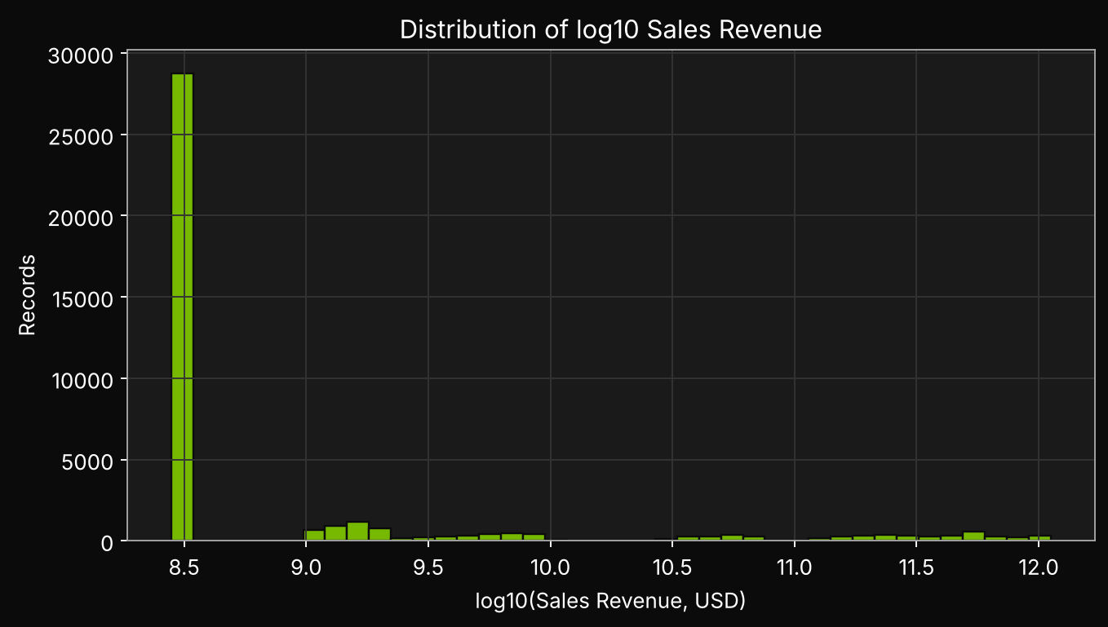
2c. Revenue Distribution
Interpretation : Revenue spans many orders of magnitude, so log scale is required.
5
Notes:
On the log10 scale revenue spans roughly 8.4 to 12 (about $280M up to $1.12T per record). The huge gap between a $307M median and a $1.1T maximum is why modelling raw revenue would let extreme values dominate.

Slide 6
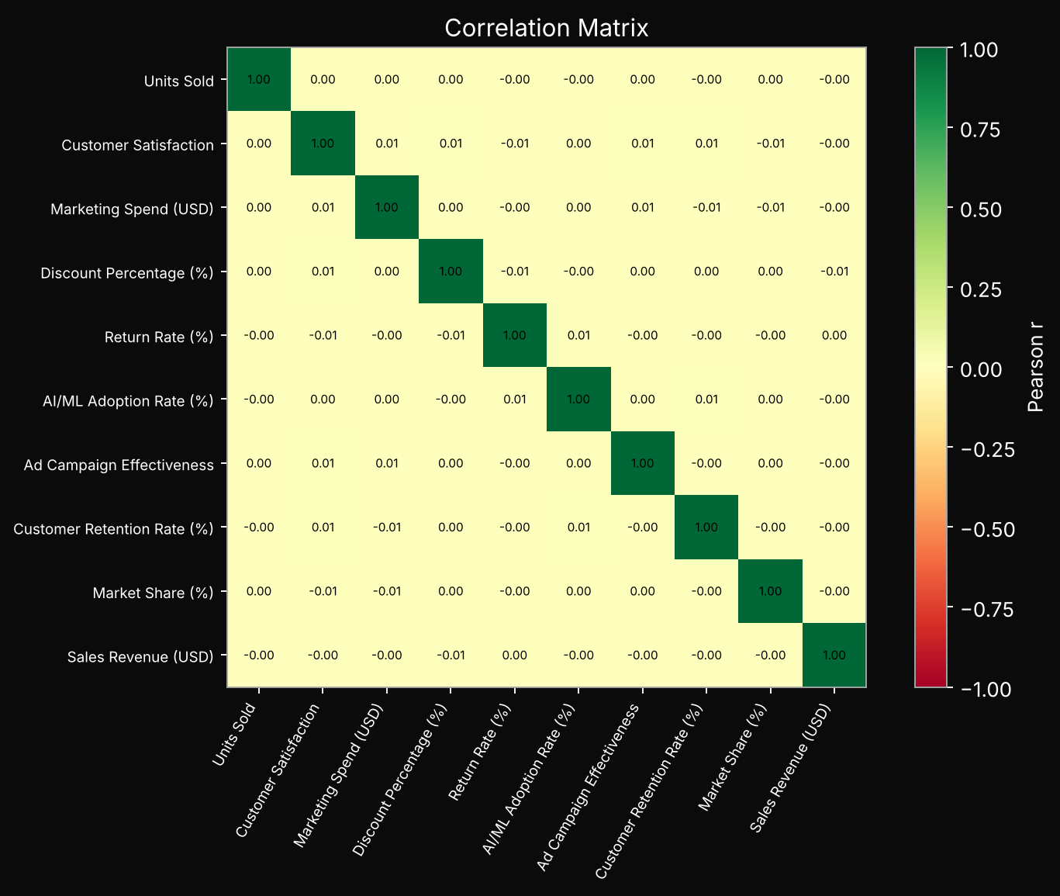
2d. Correlation Analysis
Correlation with revenue
Discount Percentage (%): -0.006
AI/ML Adoption Rate (%): -0.004
Ad Campaign Effectiveness: -0.002
Customer Retention Rate (%): -0.002
Marketing Spend (USD): -0.001
Units Sold: -0.001
Return Rate (%): 0.001
Customer Satisfaction: -0.001
Market Share (%): -0.000
Interpretation : Strongest correlate of revenue: Discount Percentage (%) (r = -0.006).
6
Notes:
Correlations between revenue and every business variable are essentially zero (Discount -0.006, AI/ML adoption -0.004, Ad effectiveness -0.002, Retention -0.002, Marketing spend -0.001). Predictors are also uncorrelated with each other, so there is no multicollinearity. Business drivers show no linear link to revenue; the real signal is time (revenue vs year r = 0.45, log revenue vs year r = 0.61). Correlation is not causation.

Slide 7
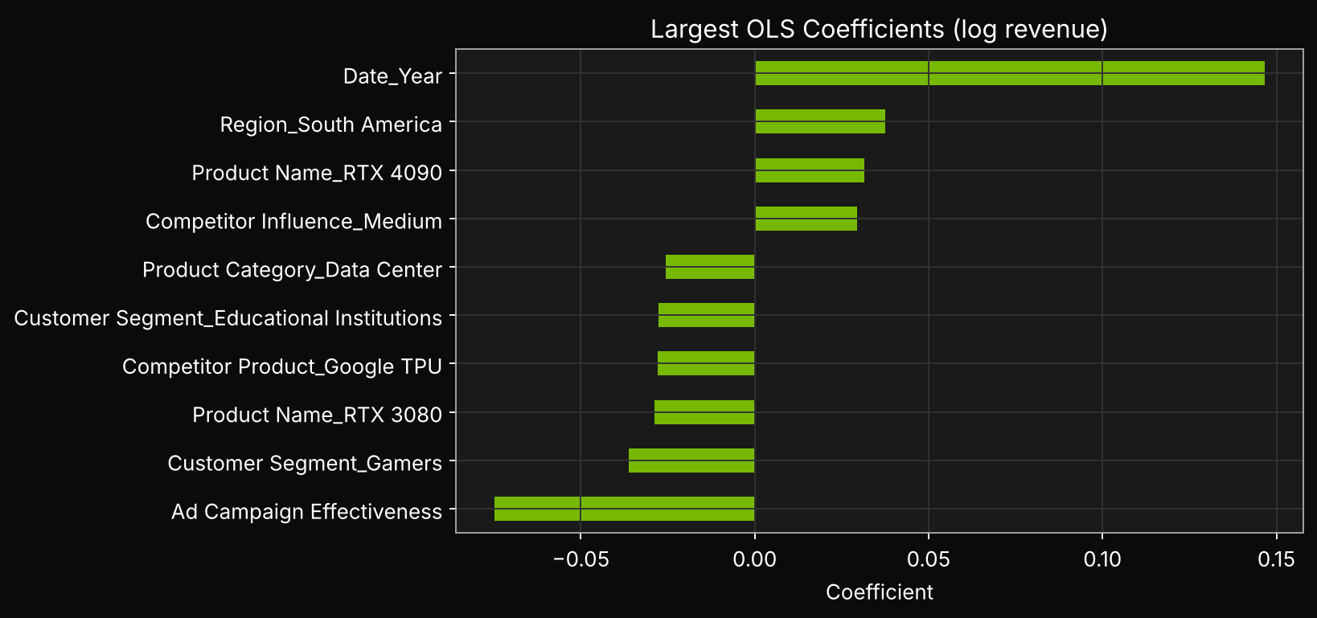
3a. Multiple Linear Regression (OLS, log revenue)
Predictor | Coefficient | Std Err | p-value
Date_Year | 0.1467 | 0.0013 | 0.00
Interpretation : R² = 0.3703; 1 predictors significant at 5%.
7
Notes:
OLS (HC3 robust errors) on log revenue: R-squared 0.370, adjusted 0.370, F = 401.4. Only ONE predictor is significant at 5%: Date_Year, coefficient 0.1467 (p < 0.001), i.e. revenue grows about 15.8% per year (exp(0.1467) = 1.158). Marketing spend, discount, AI/ML adoption, region, product and the rest are not significant. So the explanatory power comes almost entirely from the time trend.

Slide 8
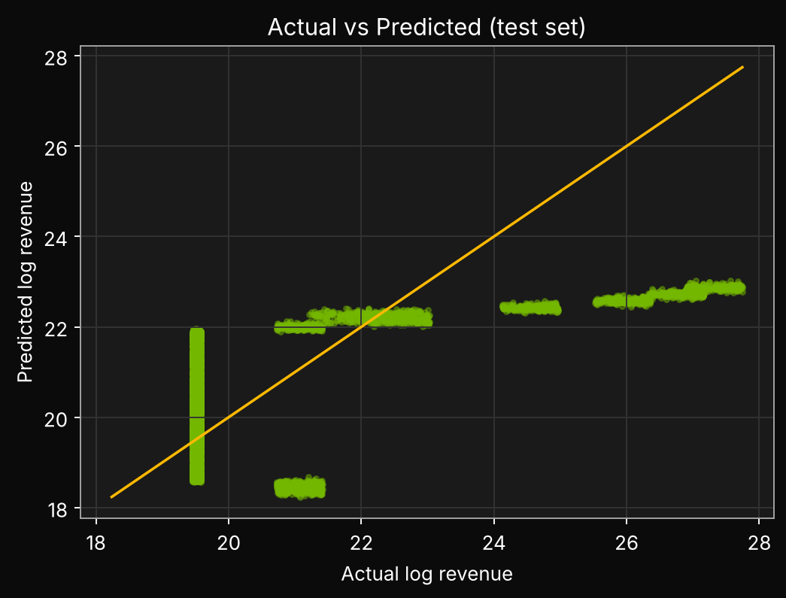
3b. Hold-out Regression Performance
Metric | Value
Test R² | 0.3837
Test MAE (log) | 1.3569
Test RMSE (log) | 1.7693
Interpretation : Test R² = 0.3837, MAE = 1.357 (log scale).
8
Notes:
Hold-out (20%) test: R-squared 0.384, MAE 1.357 on the log scale (about a 3.9x typical multiplicative error). Test R-squared is close to the in-sample 0.370, so the model is not overfitting, but it is only moderate. The remaining variance is not explained by the supplied features.

Slide 9
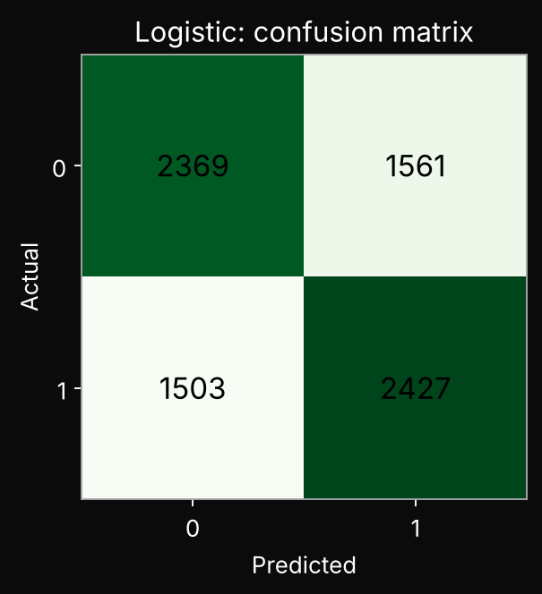
3c. Logistic Regression (High vs Low Revenue)
Model | Accuracy | ROC-AUC
Logistic Regression | 0.6102 | 0.6637
Decision Tree | 0.7682 | 0.7671
Interpretation : Accuracy 0.610; ROC-AUC 0.664 (0.5 = random guessing).
9
Notes:
Logistic regression predicting High vs Low revenue: accuracy 61.0%, ROC-AUC 0.664 (0.5 = random). Only modest separation, because a straight-line model cannot capture the sharp, non-linear jump in revenue after about 2015. The confusion matrix shows many misclassified records.

Slide 10
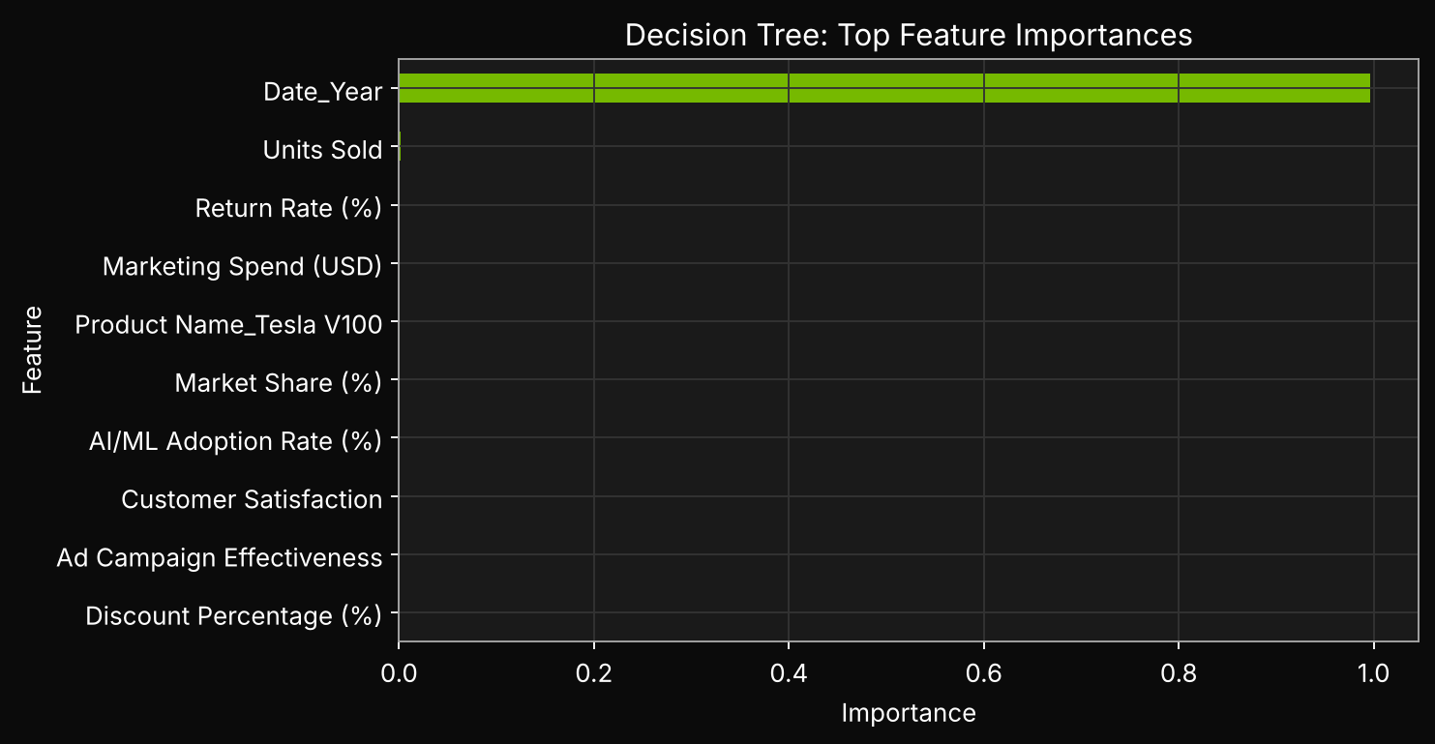
3d. Decision Tree & Feature Importance
Feature | Importance
Date_Year | 0.9965
Units Sold | 0.0013
Return Rate (%) | 0.0010
Marketing Spend (USD) | 0.0006
Product Name_Tesla V100 | 0.0006
Customer Satisfaction | 0.00
Discount Percentage (%) | 0.00
Ad Campaign Effectiveness | 0.00
Interpretation : Top predictor: Date_Year (importance 0.996).
10
Notes:
Decision tree (depth 5): accuracy 76.8%, AUC 0.767, clearly better than logistic. Date_Year has importance 0.9965; every other feature is below 0.002 (Units Sold 0.0013, Return Rate 0.0010, Marketing Spend 0.0006). The tree finds year thresholds where revenue jumps. Importance is not causation: year is a proxy for time-related growth, not a controllable driver.

Slide 11
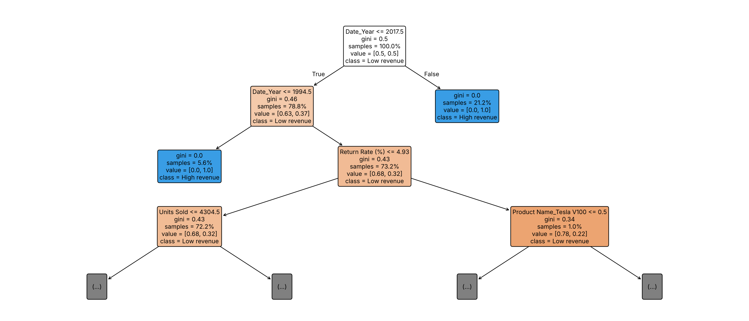
3e. Decision Tree Diagram (Branches & Split Rules)
Interpretation : Root split uses Date_Year; the tree separates High vs Low revenue mainly by year thresholds.
11
Notes:
Tree structure (original units): ROOT splits on Date_Year <= 2017.5. Right branch (year > 2017, 21.2% of records) is 100% High revenue. Left branch (78.8%) splits again on Date_Year <= 1994.5, where the 1993-94 group (5.6% of records) is also pure High revenue (a quirk of this synthetic data). The remaining middle group (1995-2017, 73.2% of records) is mostly Low revenue (about 68%) and is split by weaker rules: Return Rate <= 4.93, then Units Sold <= 4304.5 and Product Name_Tesla V100, which give only small gains. Reading the diagram: left branch = condition TRUE, right = FALSE; each box shows the rule, Gini impurity (0 = pure), share of samples and predicted class; blue = High revenue, orange = Low revenue. Interpretation: year thresholds do almost all the work, consistent with the 99.65% importance of Date_Year.

Slide 12
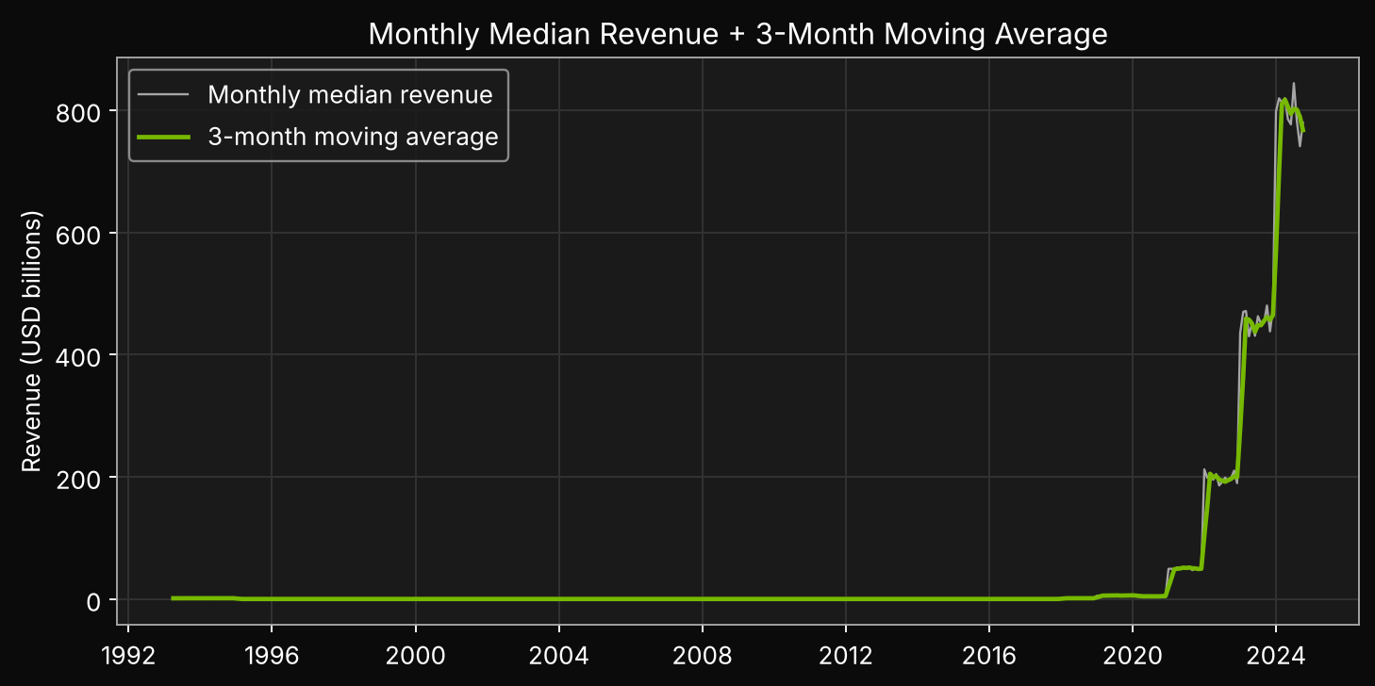
4a. Time Series: Moving Average
Interpretation : The 3-month moving average smooths month-to-month noise.
12
Notes:
Monthly median revenue over 379 months (Apr 1993 to Oct 2024). Median revenue stays near $300M through about 2015, rises to roughly $1.5B in 2015-2020, then explodes to roughly $259B in 2020-2024. The 3-month moving average smooths month-to-month spikes and shows this regime shift clearly, with a short lag.

Slide 13
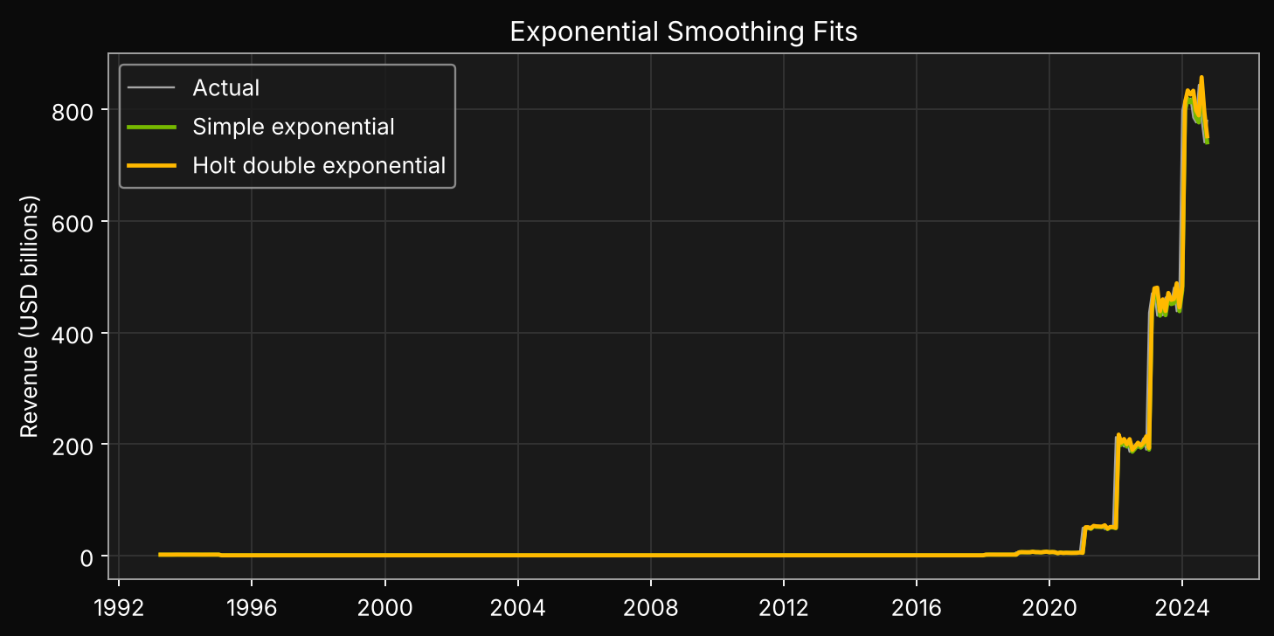
4b. Exponential & Double Exponential Smoothing
index | MAE | RMSE
3-month MA | 3,090,296,225.00 | 18,218,775,504.00
Simple Exp. | 3,960,510,260.00 | 24,015,998,443.00
Holt Double Exp. | 4,037,496,378.00 | 23,820,193,672.00
Interpretation : Lowest in-sample RMSE: 3-month MA.
13
Notes:
Simple exponential smoothing chose alpha = 1.000, which means it just repeats the last value (naive forecast). Holt double exponential: alpha 1.000, beta 0.023 (weak trend memory). In-sample RMSE: 3-month MA $18.2B (best), Holt $23.8B, SES $24.0B. The moving average fits best because the series is very noisy and jumpy. These are in-sample errors after a 3-month warm-up, not out-of-sample tests.

Slide 14
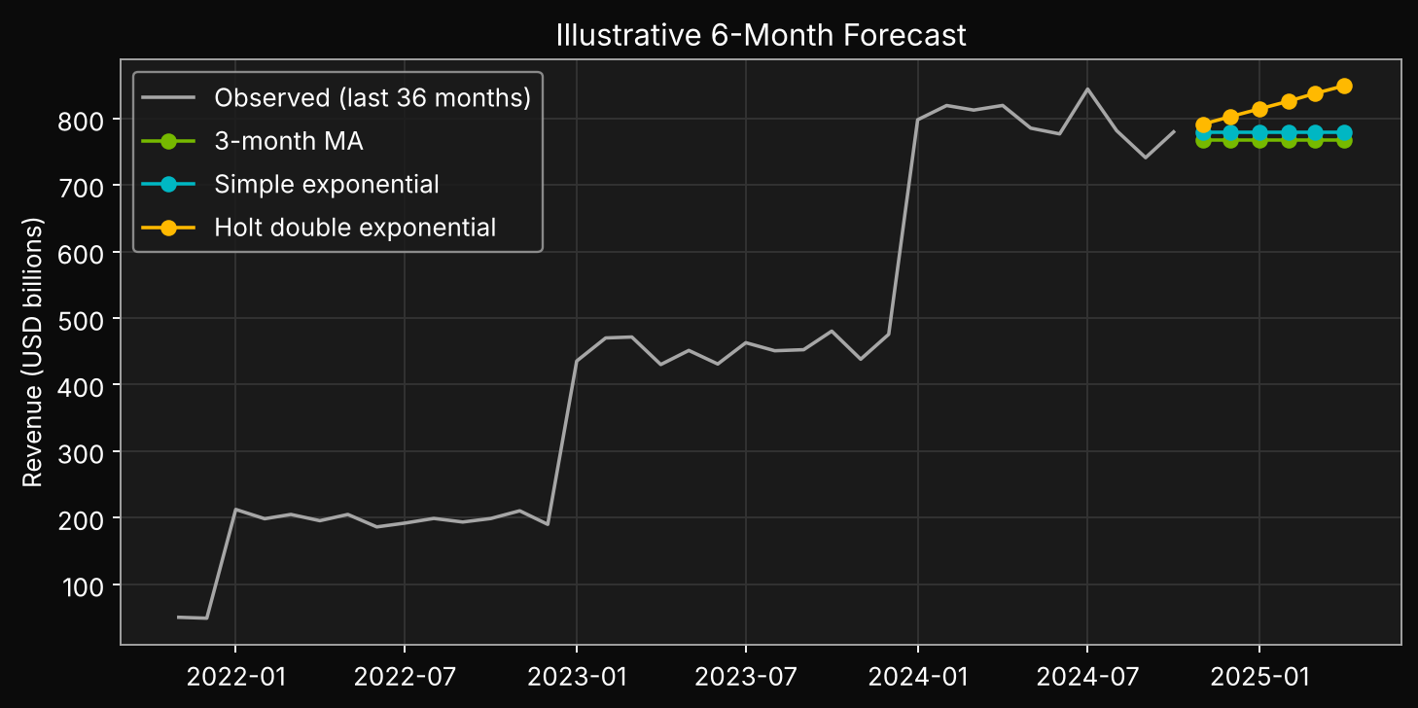
4c. Illustrative 6-Month Forecast
Interpretation : Mean forecast (USD bn): MA 767.52, SES 779.79, Holt 820.16.
14
Notes:
6-month mean forecast of monthly median revenue: MA $767.5B, SES $779.8B, Holt $820.2B. Holt is highest because it extrapolates the upward trend. Illustrative only: these values are implausible for a real company and the dataset is synthetic, so they must not be read as NVIDIA guidance.

Slide 15
5. Conclusion & Recommendations
• Revenue is highly skewed (skew 4.45); log transform used for regression.
• OLS R² 0.370; hold-out R² 0.384; logistic AUC 0.664; tree AUC 0.767.
• Strongest tree predictor: Date_Year; strongest correlate: Discount Percentage (%) (r = -0.006).
• Best time-series fit (RMSE): 3-month MA.
• Importance and correlation are not causation; metrics are exploratory.
• Data appears synthetic; validate source before presenting as real NVIDIA performance.
Code & notebook: https://github.com/YOUR-USERNAME
15
Notes:
Conclusion: (1) Revenue is extremely right-skewed, so log transform was needed. (2) Time (Date_Year) is the only meaningful driver: OLS growth about 15.8% per year, tree importance 99.7%. (3) Marketing, discount, AI/ML adoption, region and product show no measurable effect. (4) Models: OLS test R-squared 0.384, logistic AUC 0.664, tree AUC 0.767 (best). (5) 3-month moving average fits the time series best. (6) Findings are exploratory; the data looks synthetic, so validate the source before business use. Recommendation: collect richer, real data with genuine driver variation.

